Slide 1
EggBeater
Sam Adams
Taha Ainaddin
Andrew Barton
Robert Beam
Yuki Ishikawa
Sterling Miller
Sam Whitsett

Slide 2
Design

Slide 3
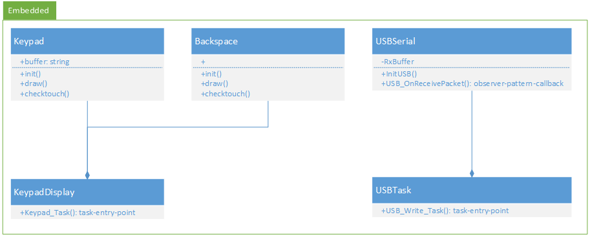
Design: Embedded

Slide 4
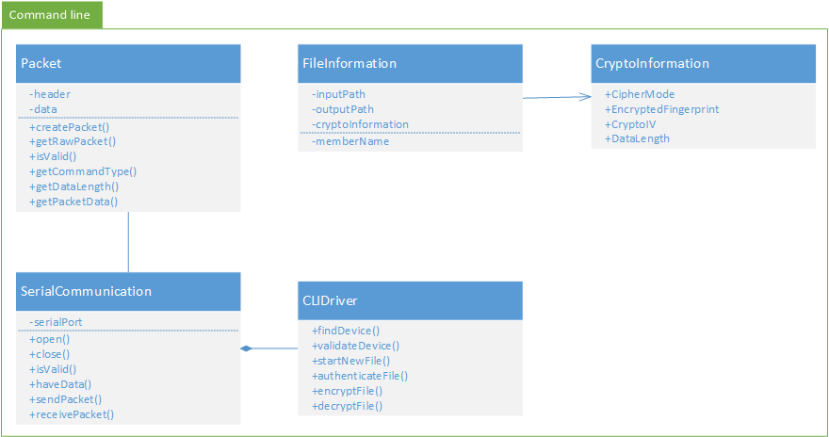
Design: Command line

Slide 5
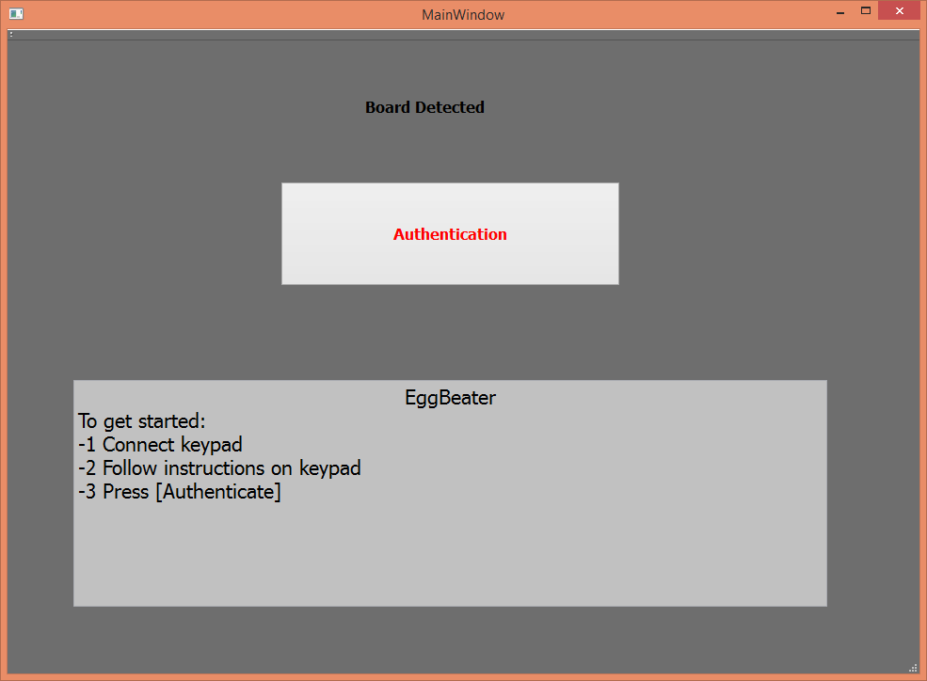
GUI mockup

Slide 6
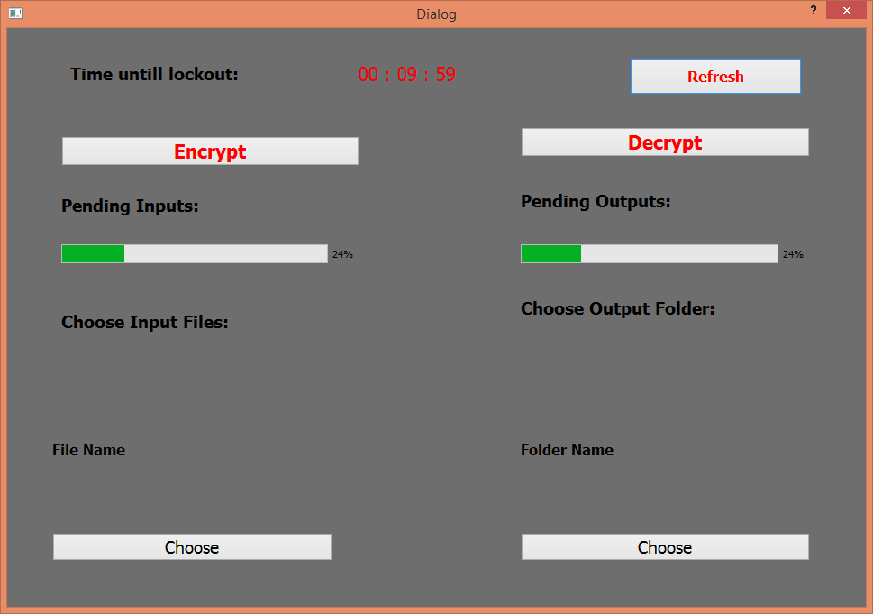
GUI mockup (cont)

Slide 7
Progress
Embedded->PC serial communication
Keypad on embedded board
Initial crypto mockup
Initial GUI mockup
Serial device discovery

Slide 8
Progress (cont)

Slide 9
Backlog
Embedded/PC packet processing
Create
Validate
Extract
GUI->Command line interaction
Discover device
Create crypto information
Encrypt file
Decrypt file

Slide 10
Testing
Unit testing
Crypto
Discovery helper methods
Acceptance testing
Hardware interactions
Device discovery

Slide 11
Maintenance
Split design between three domains
Embedded
Core tool (command line)
GUI wrapper of core tool

